Slide 1
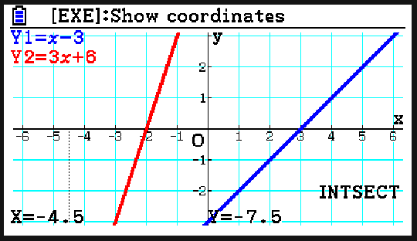
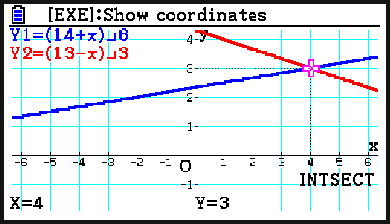
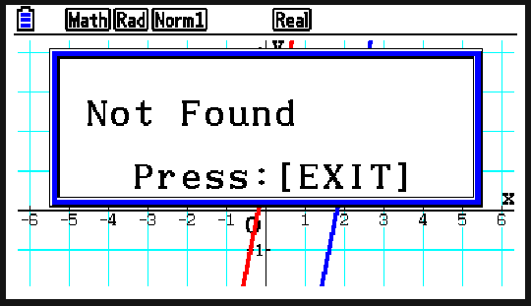
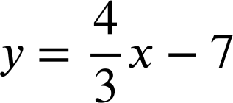
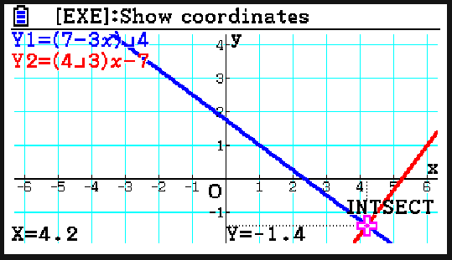
Using the fx-CG50 for number and algebra
Task A: Solving equations graphically
1) Use your calculator to solve these pairs of simultaneous equations.
a)
y = x − 3
y = 3x + 6
b)
6y − x = 14
x + 3y = 13
x = − 4.5, y = − 7.5
x = 4, y = 3
2) For each pair of simultaneous equations, write down what your calculator says when you try to solve them graphically. Why do you think the calculator gives this output?
a)
35x − 7y = 63
y = 5x + 1
E.g.
The calculator could not find a solution as there is no point of intersection.
The lines are parallel as they have the same gradient.
b)
3x + 4y = 7
E.g.
The lines have one intersection which the calculator was able to find. It displays the coordinates of the point of intersection.

Slide 2
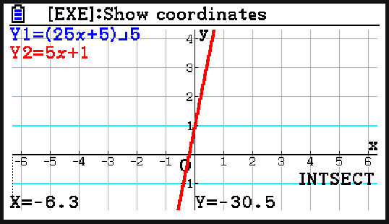
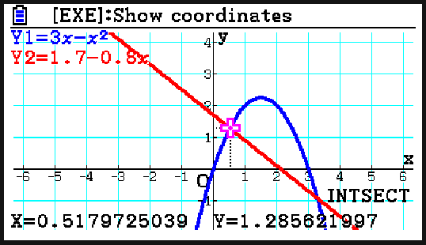
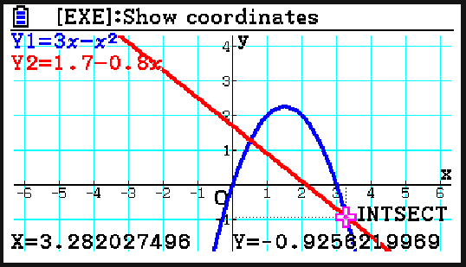
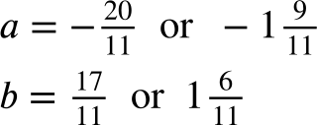
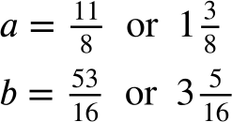
Using the fx-CG50 for number and algebra
c)
25x − 5y + 5 = 0
y = 5x + 1
E.g.
The calculator gives a point of intersection. Scrolling reveals that there are many points of intersection. This is because the two lines are the same so they have infinitely many solutions.
3) Use your calculator to estimate the solutions to this pair of simultaneous equations to 3 d.p.
y = 3x − x²
y = 1.7 − 0.8x
x = 0.518, y = 1.286
x = 3.282, y = − 0.926
Task B: Solving equations numerically
1) Solve the following pairs of simultaneous equations using your calculator.
a) b)
2a + 3b = 1
2b + a = 8
−a + 4b = 8
2b + 3 = 7a

Slide 3
Using the fx-CG50 for number and algebra
2) Calculate the solutions to these quadratic equations.
a) −x² − 8x + 20 = 0 x = −10 or x = 2
b) x² + 8x − 19 = 0
c) x² + 6x + 8 = 3 x = −5 or x = −1
d) 5x² − x + 5 = 3x² − 10x − 2 x = −1 or x = −3.5
Mathematics in Education and Industry
v2.5

